Slide 1

Lecture 9:
Risk Management
Notes:
The return on a tattlotto ticket is 60c/$. The probability of winning is more than 1 in 8,000,000. Why do people buy them? The reason is impact.
What examples of risks are there which can be avoided?
What risks cannot be avoided?

Slide 2
Risk Management
What is risk?
A potential problem – might or might not happen
Two elements:
Probability
Impact
Can we avoid risks?
We are concerned about
risks we run in the software development project
risks that users run when they use our system
  Results, Side effects, Medical, Legal
Notes:
The return on a tattlotto ticket is 60c/$. The probability of winning is more than 1 in 8,000,000. Why do people buy them? The reason is impact.
What examples of risks are there which can be avoided?
What risks cannot be avoided?
Not static
Freud who said the purpose of life is to avoid pain and experience pleasure.

Slide 3
Risk Management
Risk is generally proportionate to the gain.
  Risk of having a child
  It could kill you while you are younger and take your money/stuff.
  It could feed you when you are old and frail.
http://www.youtube.com/watch?v=wj7egw8wLRU
Notes:
Big companies take big risks for big returns….

Slide 4
Reactive and Proactive Risk Strategies
Reactive:
“Don’t worry! I’ll think of something”
Fire fighting
Proactive:
Identify potential risks
Assess the likelihood of their happening
Estimate their impact
Make a plan and work the plan
Notes:
It is quite legitimate to be reactive to a risk. This is known as running the risk. The mistake is to ignore risk and not make a judgement about it.
Mark
vs.
Ken

Slide 5
4 Ways To Manage Risks
Avoid – e.g. dodging a punch
  Carefully select the right employees
Prevent – cutting off the boxer’s arm
  Fire bad employees
Reduce likelihood – open your eyes
  Planning and design
Contingency plan – Roll with the punch
  Extend budget or time plan.
Notes:
It is quite legitimate to be reactive to a risk. This is known as running the risk. The mistake is to ignore risk and not make a judgement about it.

Slide 6
Risk Categories
Project risks threaten the plan
impact is on delivery date, budget overrun
factors are project complexity, size, structural uncertainty
Technical risks threaten the quality, timeliness of the software
problems with the process of software development
problems with specification
problems with leading edge developments
Digiquant VoIP
Business risks threaten the viability of the software
building a system no one wants
building a product that does not fit the strategy of the company
building a product that sales does not understand
losing the support of senior management
losing budgetary or personnel commitment
Notes:
Technical risks can also impact the plan.
Business risks are external to the project – the environment of the project is set by business decisions.

Slide 7
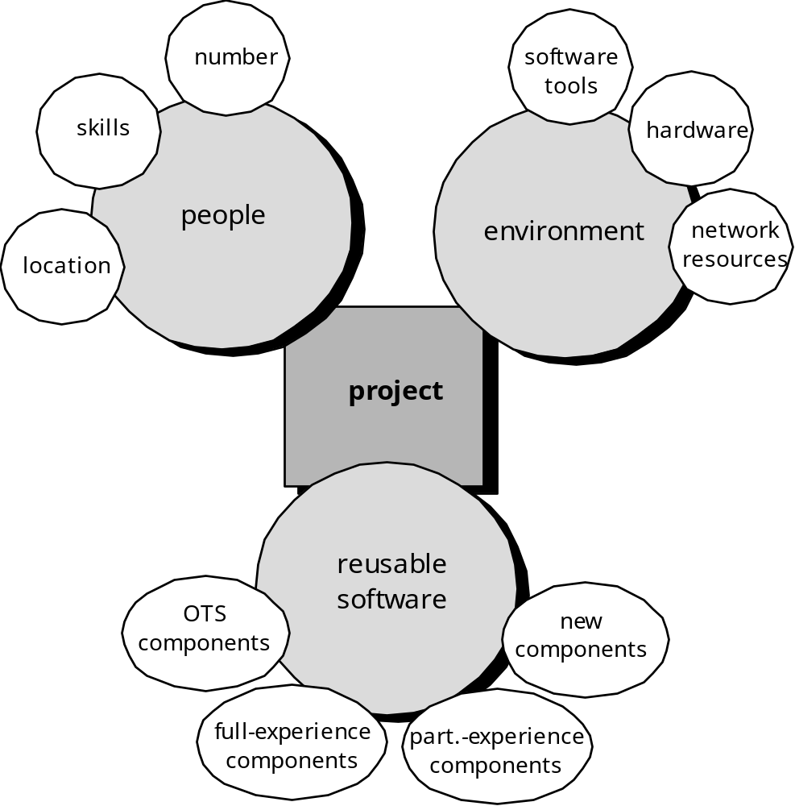
Risk Identification (1)
Notes:
The 5th edition of Pressman does not list these checklists. With permission of the publisher, a copy of chapter 6 is available on WebCT.

Slide 8
Risk Identification (1)
Software Engineering
Software Engineering
tools
methods
process model
a “quality” focus
Notes:
The 5th edition of Pressman does not list these checklists. With permission of the publisher, a copy of chapter 6 is available on WebCT.

Slide 9
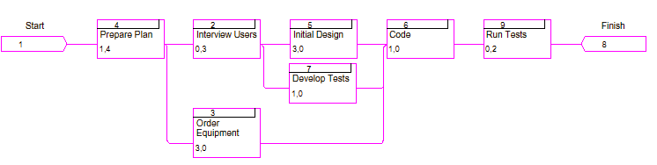
Risk Identification (1)
Risk Assignment
Risks #5, 6, 7 and 8
Risk #2
Risk #3
Risk #1
Risk #4
Notes:
The 5th edition of Pressman does not list these checklists. With permission of the publisher, a copy of chapter 6 is available on WebCT.

Slide 10
Risk Identification (2)
Section 25.3 in Pressman presents a checklist of risks:
Product size
Business impact: constraints imposed by management or marketplace
Customer characteristics
Process definition
Development environment
Technology to be built
Staff size and experience
Risk identification can be done by asking a series questions
Notes:
The 5th edition of Pressman does not list these checklists. With permission of the publisher, a copy of chapter 6 is available on WebCT.

Slide 11
Overall Project Risk
Section 25.3.1 in Pressman presents a set of questions that are ordered by their relative importance to the success of a project, such as:
Have top software and customer managers formally committed to support the project?
Are end-users enthusiastically committed to the project and the system/product to be built? Age….
Are requirements fully understood by the software engineering team and their customers?
….
The project risk degree is directly proportional to the number of negative responses to these questions
Notes:
The 5th edition of Pressman does not list these checklists. With permission of the publisher, a copy of chapter 6 is available on WebCT.

Slide 12
Product Size Risk Factors
Estimated size of the product in LOC or FP
Estimated size in number of programs, files, transactions
Deviation in size of product from average of previous products
Number of users
Size of database
Number of changes before and after delivery
Amount of reused software
Confidence in the estimate
If these quantities are large or deviate significantly from previous projects, then the risk is high
Or if numbers are similar but previous experience less than satisfactory, the risk is high.
Notes:
With Risk Size matters:
Size of impact
Size of probability
Size of system
Size of team

Slide 13
Customer Related Risk Factors
Customer related factors are:
Have you worked with the customer before?
Does the customer have a good idea of what is wanted?
Will the customer spend time determining the project scope?
Is the customer willing to establish rapid communication with the developer?
Is the customer willing to take part in reviews?
Is the customer technically sophisticated in the product area?
Is the customer willing to let you do your job?
Is the customer arrogant?
Does the customer understand the software development process?
Customer’s litigation history?
If the answer is “no” to any questions, there is potential risk to be investigated.

Slide 14
Process Risk Factors
Do you have a standard process? Is it documented? Is it used on other projects? Are staff knowledgable of and committed to using it?
Does your company developed training or use training courses?
Are published standards provided to developers and managers? Is there a mechanism for ensuring that work conforms with standards?
Have document outlines and examples been prepared for all deliverables?
Are formal technical reviews of the requirements specification, design and code to be conducted regularly? Also for test procedures and cases? Are the results of these reviews documented?
Is a mechanism for managing change used?
Is there a documented statement of work, an SRS, a SDP?
Is there a procedure for tracking and reviewing subcontractors?
Answers of “no” identifies a weakness

Slide 15
Technical Risk Factors
Are Facilitated Application Specific Techniques (FAST) used to aid communication between developer and client?
Are specific methods used for software analysis? design? implementation? testing? Are they consistent for all team members?
Is more than 90% of code written in a high level language?
Are specific conventions used for code documentation defined and used?
Are software tools used
for planning and tracking?
to control and track change (configuration management)?
to support analysis and design?
to create prototypes?
to support testing?
to manage documentation?
Are metrics collected for all software projects?
A “no” answer to these questions indicates weakness.

Slide 16
Resource Risk Factors
Loss of hardware: theft, damage, explosion
Loss of software or data: worms, virus, expired license
Loss of people: death or injury
Financial: Are we overextended that we can’t pay electricity bills? Or can’t buy required software?

Slide 17
Proactive Approach to Risk
A series of activities:
Identification of risks using checklists and corporate databases
e.g. Pressman’s checklists
Analysis of risks to see how they affect the project
Impact – Catastrophic, critical, marginal, negligible
Risk driver component – Performance, support, cost, schedule
Risk prioritisation by rating
Probability
Impact
Planning for the likely, high impact risks:
Avoid
Control – Plan, monitor, resolve
Notes:
A risk that is 100% likely means that managing it is part of the project.

Slide 18

USAF Risk Components and Drivers
1- the potential consequence of undetected errors and faults
2- the potential consequence if the desired outcome is not achieved
Notes:
This is the full table.
Using this table: For a given risk driver (e.g. performance), the category of risk can be determined by matching a description to an event and determining the risk category.

Slide 19
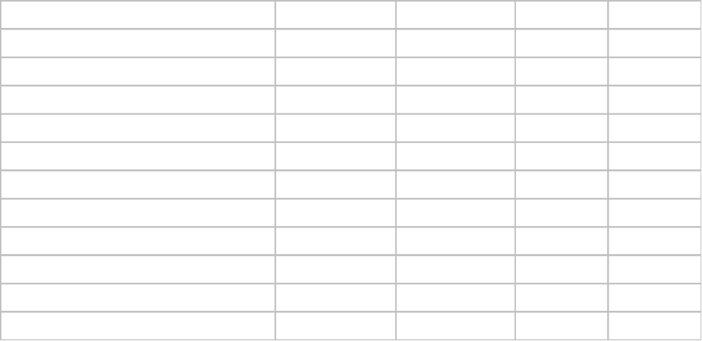
Risk Table
Average of 4 risk component impact values
PS-Project size risk BU-business risk CU- customer etc
Impact values: 1-catastrophic 2-critical 3-marginal 4-negligible
RMMM- Risk Mitigation, Monitoring and Management Plan
Notes:
The first column is risk identification
The second is categorised by the kind of risk
The third is the estimate of probability
The fourth is the impact category, as in the USAF table
The fifth column identifies the item in the risk management document related to that risk.
The table is then sorted so that the likely, high-impact risks are at the top and the unlikely low impact risks at the bottom.
A cut-off line can be drawn across the table. Risks above will be managed. Risks below will be run.

Slide 20
RMMM Plan
RMMM: Risk Mitigation, Monitoring and Management
Mitigation—how can we avoid the risk?
Monitoring—what factors can we track that will enable us to determine if the risk is becoming more or less likely?
Management—what contingency plans do we have if the risk becomes a reality?
RMMM Plan: documents all work performed as part of risk analysis, and is used by the project manager as part of the overall project plan
Alternatively, each risk is documented individually using a risk information sheet (RIS)

Slide 21
Risk Information Sheet (RIS)
Risk Information Sheet
Risk ID: | Date: | Probability: |  | Impact:
Description:
Refinement/context:
Mitigation/monitoring:
Management/contingency plan/trigger:
Current status:
Originator: |  |  | Assigned:
Implement in a Database!
An example of RIS: Pressman Figure 25.4 (page 708)

Slide 22
Summary
Risk involves uncertainty and loss
The uncertainty is expressed as a probability
The loss is the impact of the risk being run occurring
We must attempt to control risk (“We cannot eliminate risk. But we can take the right risks” – Peter Drucker)
We can avoid some risks, we can reduce the impact of others.
We need to anticipate risk. This is can be done by using checklists and people with experience.
To control risk effectively, we need a Risk Management Plan.
The Risk Management Plan will cover the more likely higher impact risks, and help identify what should be done before running the risk.

Slide 23
Readings
Pressman (6th edition)
Chapter 25: Risk Management
http://www.youtube.com/watch?v=Fzwbbzu-nDA

Slide 24
Tutorial
Risk Analysis
Event Tree Analysis
&
Fault Tree Analysis

Slide 25
Event Tree Analysis
Key Points

Slide 26
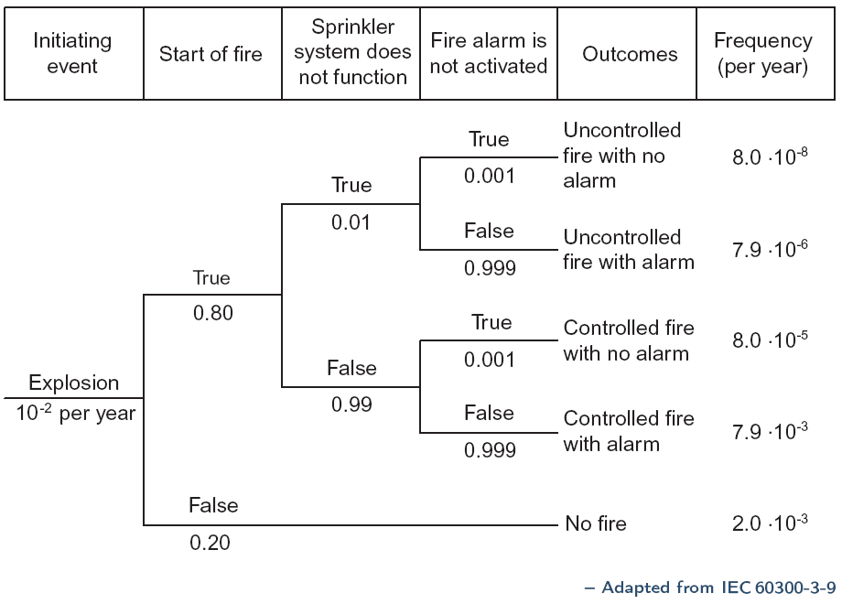
Event Tree Analysis Example
8.0 E-8
7.99E-5
7.92E-6
7.91E-3
2E-3

Slide 27
Event Tree Analysis - Steps
1. Identify a relevant accidental event that may give rise to unwanted consequences (Starting Point)
2. Identify the barriers that are designed to deal with the accidental event. (What order are they used?)
3. Construct the event tree. Each path through the tree should be a potential accident sequence
4. Determine the frequency of the accidental event and the probabilities of the branches in the event tree
5. Calculate the probabilities for the identified consequences (outcomes). Group results with common outcomes.

Slide 28
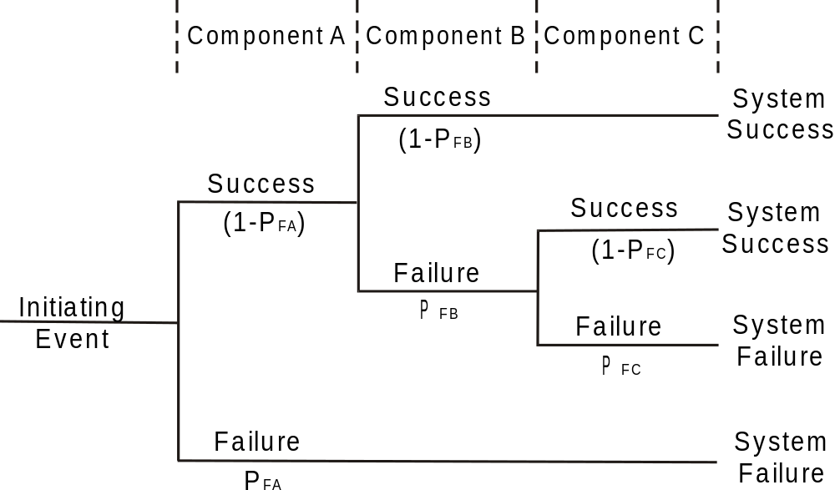
Event Tree Diagram

Slide 29
ETA Numeric Analysis
Probability of success given the event is
  Sum of probabilities for each path leading to success
  In the preceding example:
  (1-P_{FA}) * (1-P_{FB}) + (1-P_{FA}) * P_{FB} * (1-P_{FC})
Failures assumed to be statistically independent

Slide 30
Event Tree Analysis
Tutorial Exercise

Slide 31
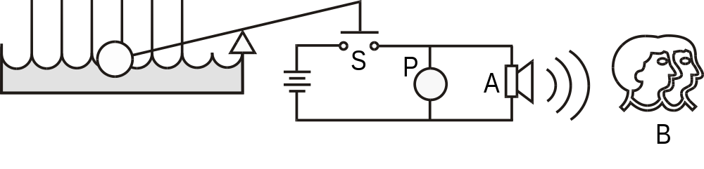
Flood Prevention System
The reservations division system for a major airline occupy a 10 story building. The basement of the building contains a backup generator so that 24/7 availability can be maintained even during black-outs. In heavy rain the basement is prone to minor flooding. The basement is protected from flooding by the system shown in Figure 1.
Rising flood waters close the float switch S, powering the pump P from an uninterruptible power supply. An Alarm A also sounds, alerting operators (assume the operator will always respond) to perform manual pumping using a bilge pump, B, should the automatic pump P fail. Correct operation of either of the pumps will effectively keep the basement from flooding
Construct an Event Tree for this system

Slide 32
Event Tree Analysis
Hints for this tutorial
Need to establish sequence of operation for components.
  The pump and alarm operate simultaneously but in terms of design the pump is primary and the alarm is only of consequence if the pumps fails.
A component’s operation is either success or failure. There is no partial success.
  eg a damaged pump may have sufficient capacity to deal with some floods. ETA cannot handle partial operation. Such a pump is treated as being a failure.
The quantitative analysis component does not consider correlated failures.
  For example consider the situation where the automatic pump fails due to poor maintenance practices. The likelihood that the manual bilge pump will also fail is higher due to poor maintenance.

Slide 33
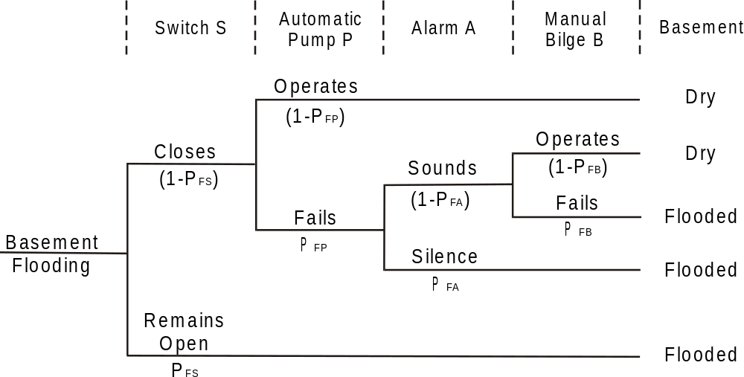
Event Tree - Solution
Exercise 2
Now calculate the probabilities of the paths through the event tree and the outcomes
Component | Probability of Failure on Demand
Automatic Pump (P) | 1e-4
Switch (S) | 1e-6
Alarm (A) | 1e-5
Manual pumping (B) | 1e-4

Slide 34
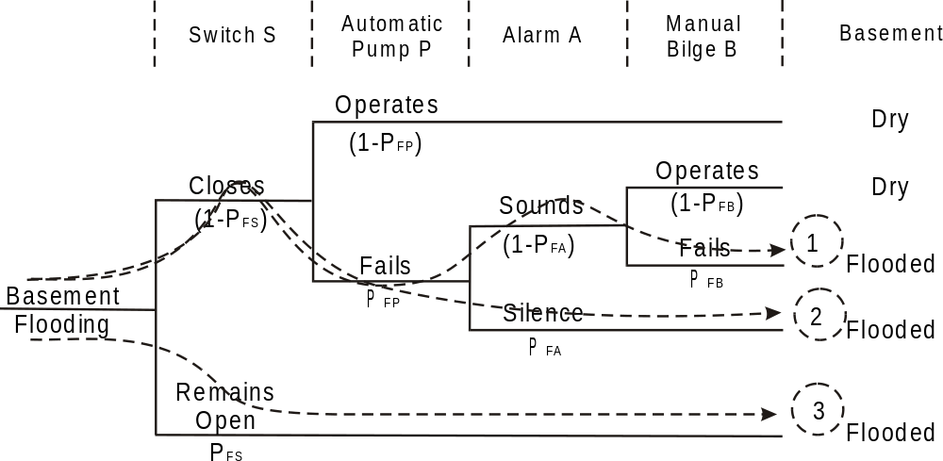
Probability Event Tree - Solution
The probability of path 1 is: P1 = (1-PFS) * PFP * (1-PFA) * PFB
The probability of path 2 is: P2 = (1-PFS) * PFP * PFA
The probability of path 3 is: P2 = PFS
The probability of flooding as a result of water flowing into the basement is
P(flood | water) = PF = P1 + P2 + P3 = (1-PFS) * PFP * (1-PFA) * PFB + (1-PFS) * PFP * PFA + PFS

Slide 35
Event Tree Analysis
Approximation probability of failure of any given device is much less than one. Thus (1-PF) ≈ 1. Thus,
PF = PFP * PFB + PFP * PFA + PFS = PFP * (PFA + PFB) + PFS
= 1e-4 * (1e-5 + 1e-4) + 1e-6
= 1.1e-8 + 1e-6
= 1.011e-6
System Improvement
  By inspection the switch is the critical element. Based on the failure-on-demand probabilities provided, the switch has a probability of failure two orders of magnitude greater.

Slide 36
Fault Tree Analysis
Key Points

Slide 37
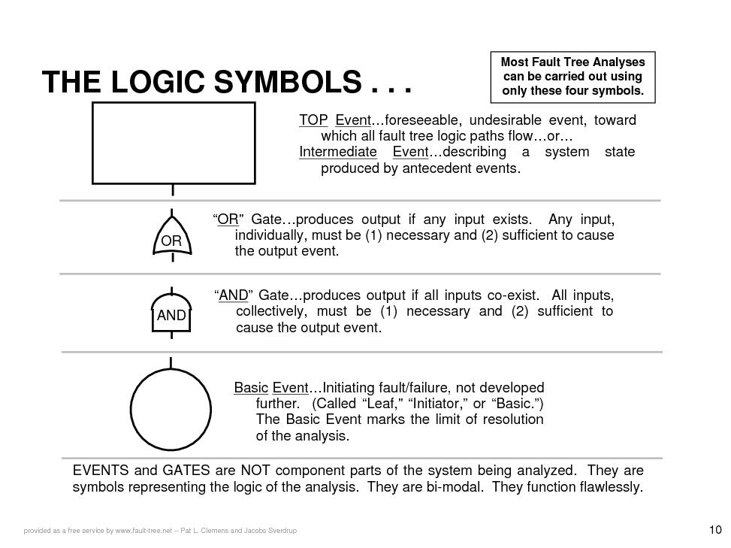

Slide 38
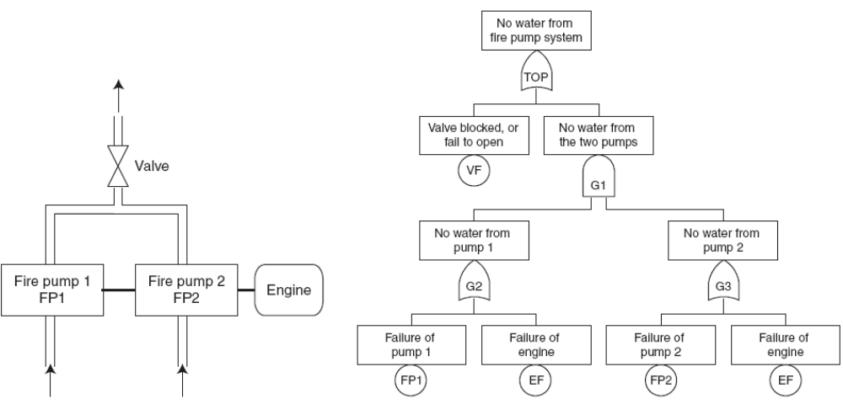
Fault Tree Analysis
Redundant Fire Pumps
System Reliability Theory (2nd ed), Wiley, 2004

Slide 39
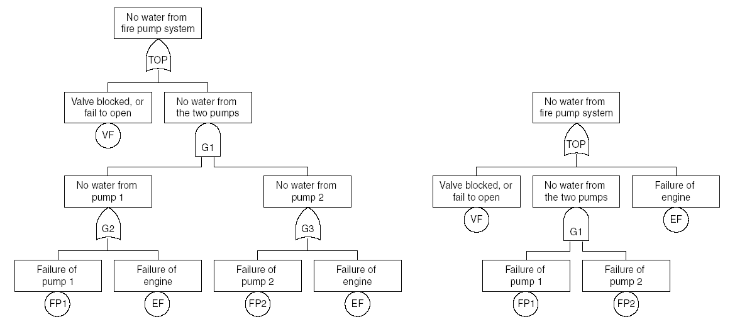
Representing the Fault Tree
The two fault trees above are logically identical. They give the same information.

Slide 40
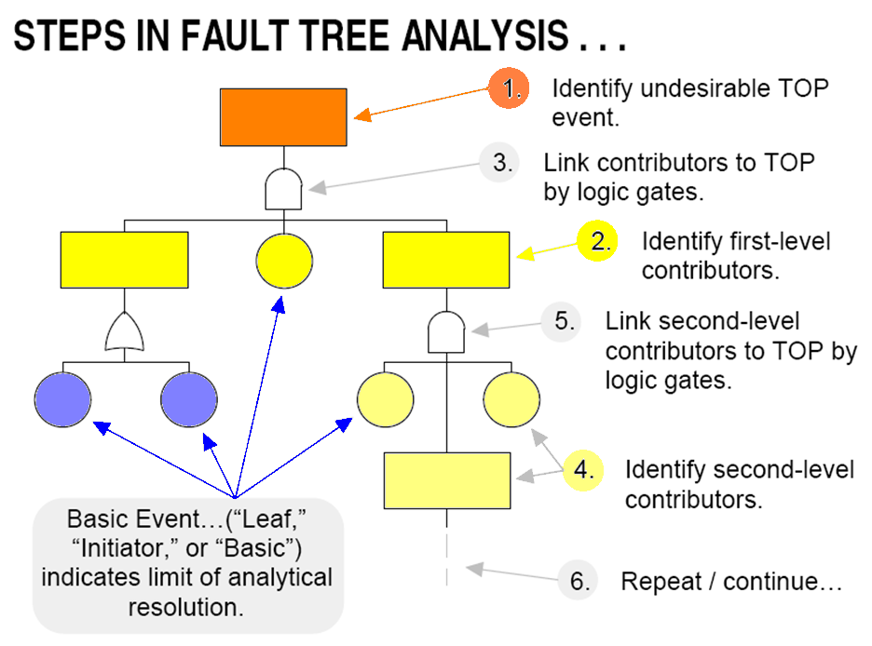
Constructing the Fault Tree …
www.fault-tree.net -- Pat L. Clemens and Jacobs Sverdrup

Slide 41
Fault Tree Analysis - Steps
Definition of the system, the TOP event
(the potential accident), and the boundary conditions
Construction of the fault tree
Identification of the minimal cut sets
Qualitative analysis of the fault tree
Quantitative analysis of the fault tree
Reporting of results

Slide 42
Cut Set and Minimal Cut Set
A CUT SET…is any group of fault
tree initiators which, if all occur, will cause the TOP event to occur.
A MINIMAL CUT SET…is a least
group of fault tree initiators which, if all occur, will cause the TOP event to occur.
www.fault-tree.net -- Pat L. Clemens and Jacobs Sverdrup
Notes:
Cut set is a terminology = fault set or failure set
48240 Design Fundamentals (c) UTS
SPRING 2011
John Gardner

Slide 43
Single Point of Failure
“A Failure of one independent element of a system which causes an immediate hazard to occur and/or causes the whole system to fail.”
Professional Safety — March 1980

Slide 44
Fault Tree Analysis
Tutorial Exercise

Slide 45
Flood Prevention System
The reservations division system for a major airline occupy a 10 story building. The basement of the building contains a backup generator so that 24/7 availability can be maintained even during black-outs. In heavy rain the basement is prone to minor flooding. The basement is protected from flooding by the system shown in Figure 1.
Rising flood waters close the float switch S, powering the pump P from an uninterruptible power supply. An Alarm A also sounds, alerting operators (assume the operator will always respond) to perform manual pumping using a bilge pump, B, should the automatic pump P fail. Correct operation of either of the pumps will effectively keep the basement from flooding
Construct an Fault Tree for this system

Slide 46
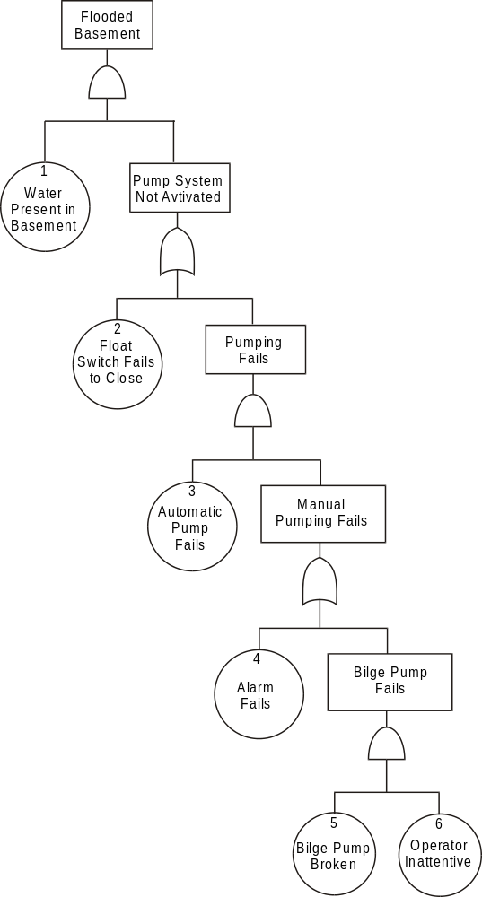
Fault Tree Diagram For Flood Prevention System
Solution

Slide 47
FTA Quantitative Analysis
Student Exercise –
  a) determine the likelihood of the top event using the failure data for the components.
  b) compare the FTA result with the ETA results. Why is there a difference?
Component | Probability of Failure on Demand
Automatic Pump (P) | 1e-4
Switch (S) | 1e-6
Alarm (A) | 1e-5
Manual pumping (B) | 1e-4
Notes:
The FTA has an AND gate - the probability of pumping failure is when the automatic AND manual pumping fails

Slide 48
Further Fault Tree Analysis
Question:
  Determine if there are any single points of failure?
  What could be done to improve the system to remove these single points of failure.
Answer:
  Single points of failure are identified by the cut sets elements containing only two events, the driving event (water present in the basement) and the point of failure.
  So in this example, the float switch is a single point of failure.

